Slide 1

Functional Programming in Python
Twin Panitsombat (RuuF)
Software Stylist @ ODDS-TEAM

Slide 2

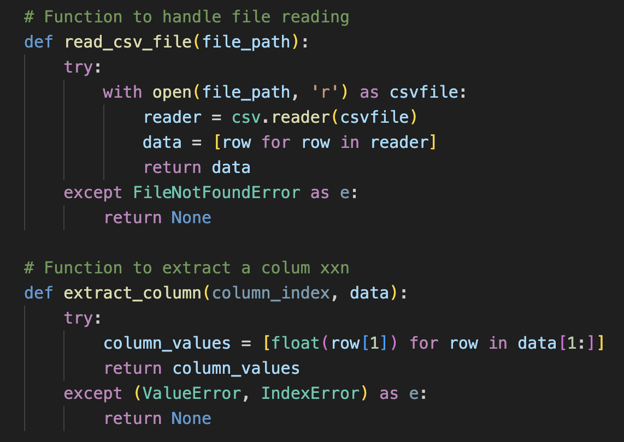
Interactive Session
Check out code from here https://github.com/roof42/python-monad-pymonad

Slide 3

About Us

Slide 4

A vibrant community of 470 individuals united by the belief that software development should be a joyful endeavor. We advocate for deliberate practice as a means to enhance our skills and bring the spirit of joy to the world of coding.

Slide 5
Single Department with Team Based Organization
CUSTOMER 1
CUSTOMER 2
.
.
.
CUS 13
Feature
Feature
Feature
…
Feature
Feature
Feature
TEAM1
TEAM2
TEAM3
…
TEAM45
TEAM46
TEAM60
AREA 1
AREA 2
AREA 3
.
.
.
AREA 13
ODDS (Platform) – Team Based Organization

Slide 6
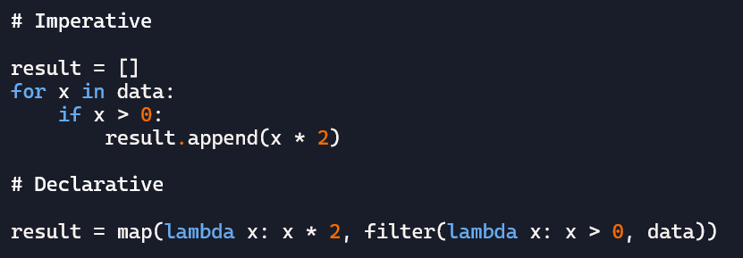
Single Department with Team Based Organization
Declarative Style
In functional programming, declarative means expressing
what you want to achieve, not how to do it.
Instead of writing step-by-step instructions (imperative), you describe transformations and relationships between data.

Slide 7
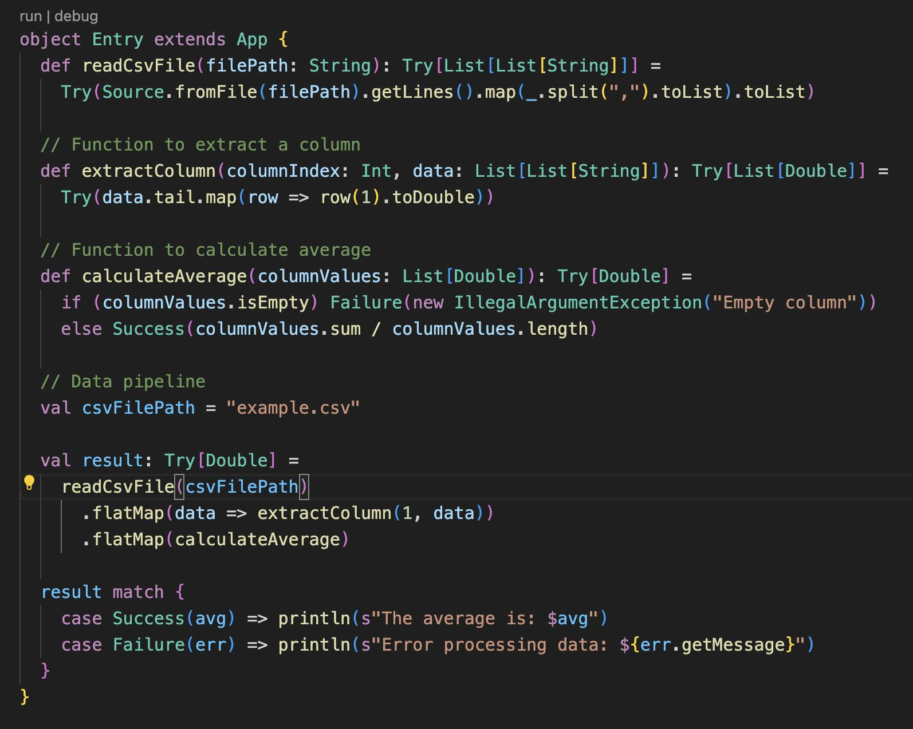

The beginning

Slide 8
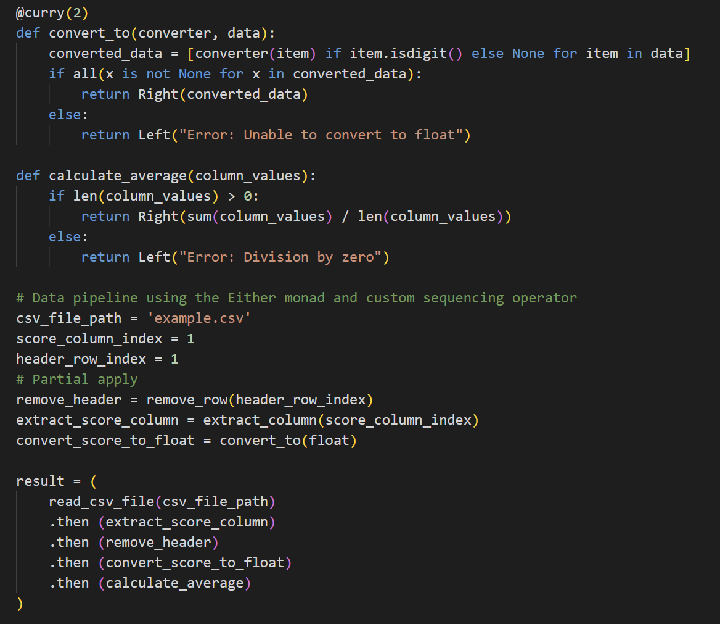


The End

Slide 9
Functional Programming Concepts
A function should do one thing and do it well
Currying
Higher Order Functions
Arity
Function Composition
Monads
concept
concept
concept
concept
concept

Slide 10
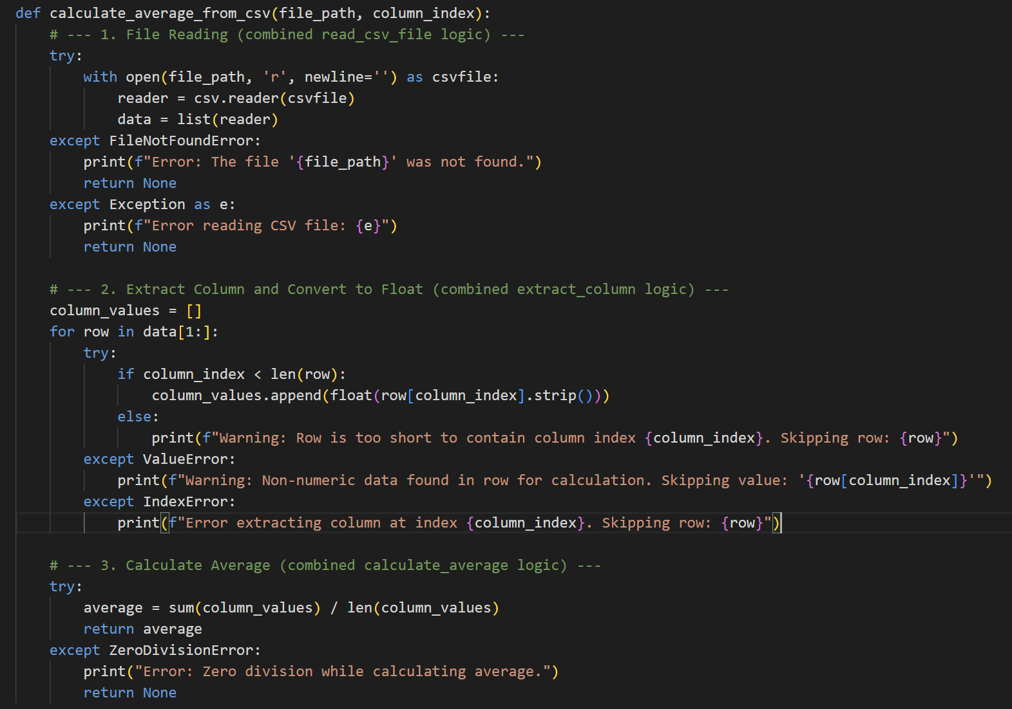
Imperative Style

Slide 11
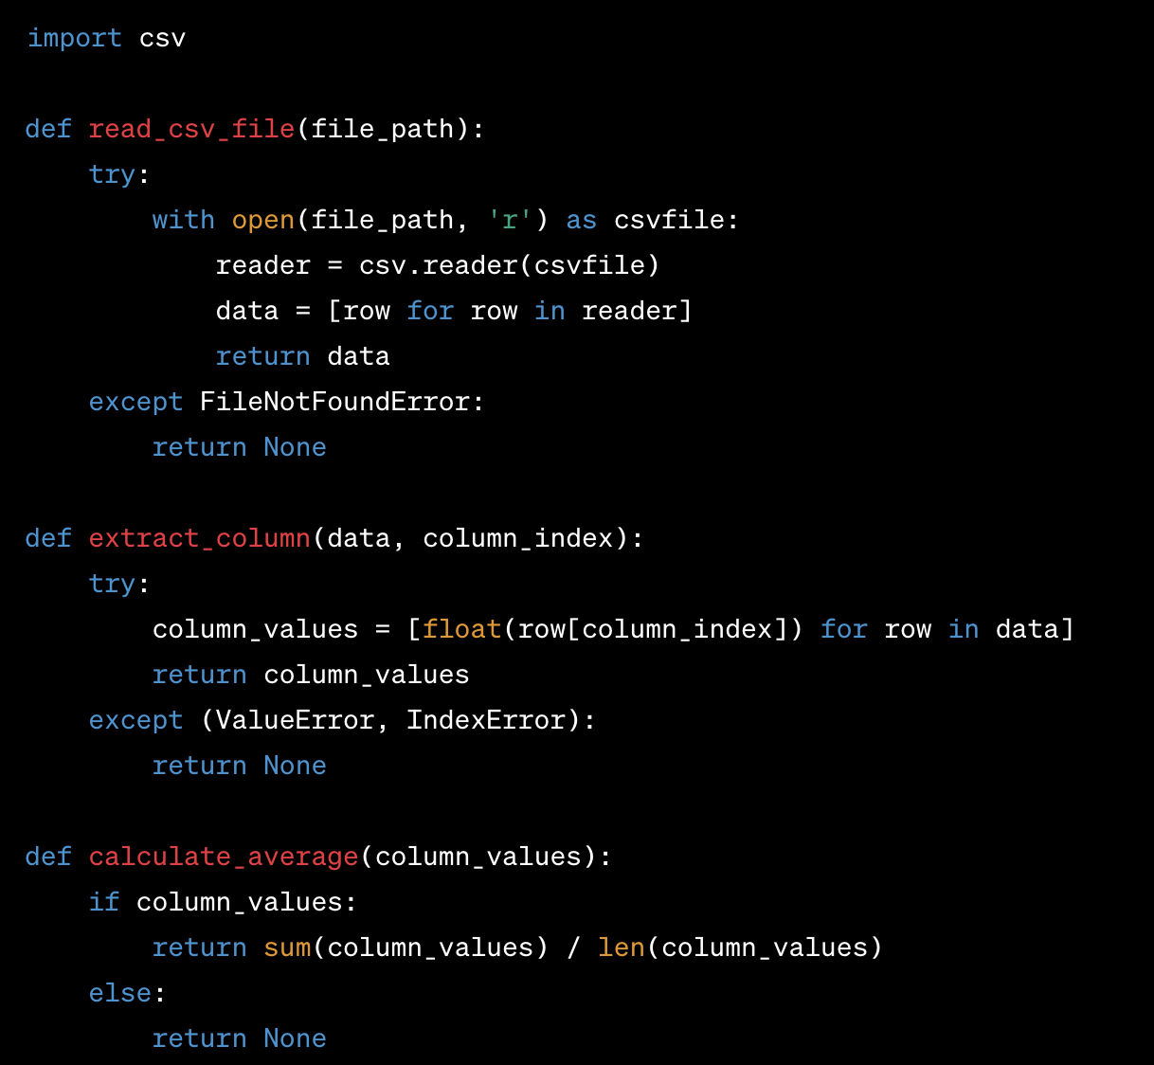
Standard Python

Slide 12
Do one thing and do it well
In general, all the things in a function should be at the same abstraction level. A function should not have both lower-level and higher-level details. If another function can be extracted out of a function, then it is doing more than one thing.

Slide 13
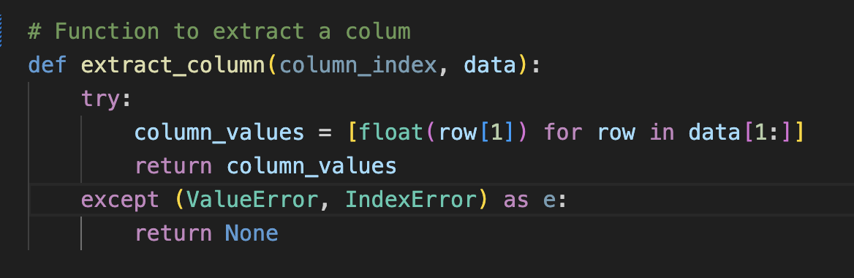
How many thing is this function do
Extract and ?

Slide 14
Extract to ?
Extract and Convert then
In 30 seconds

Slide 15
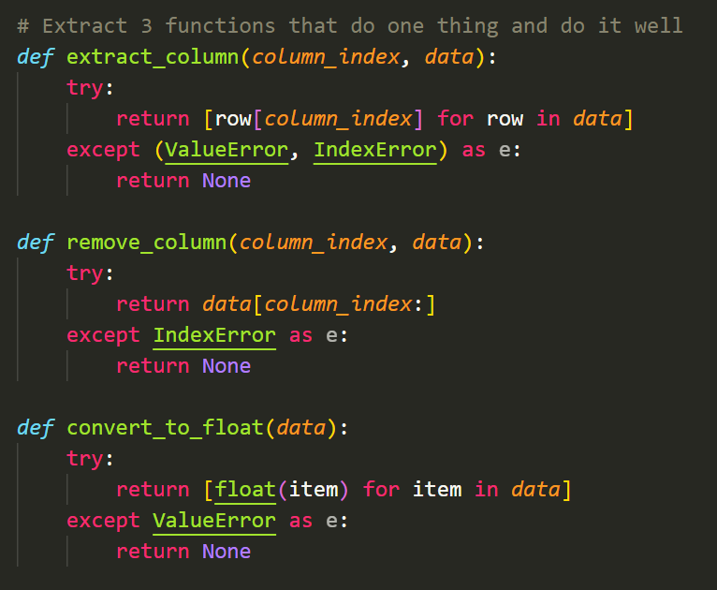
Extract to ?

Slide 16
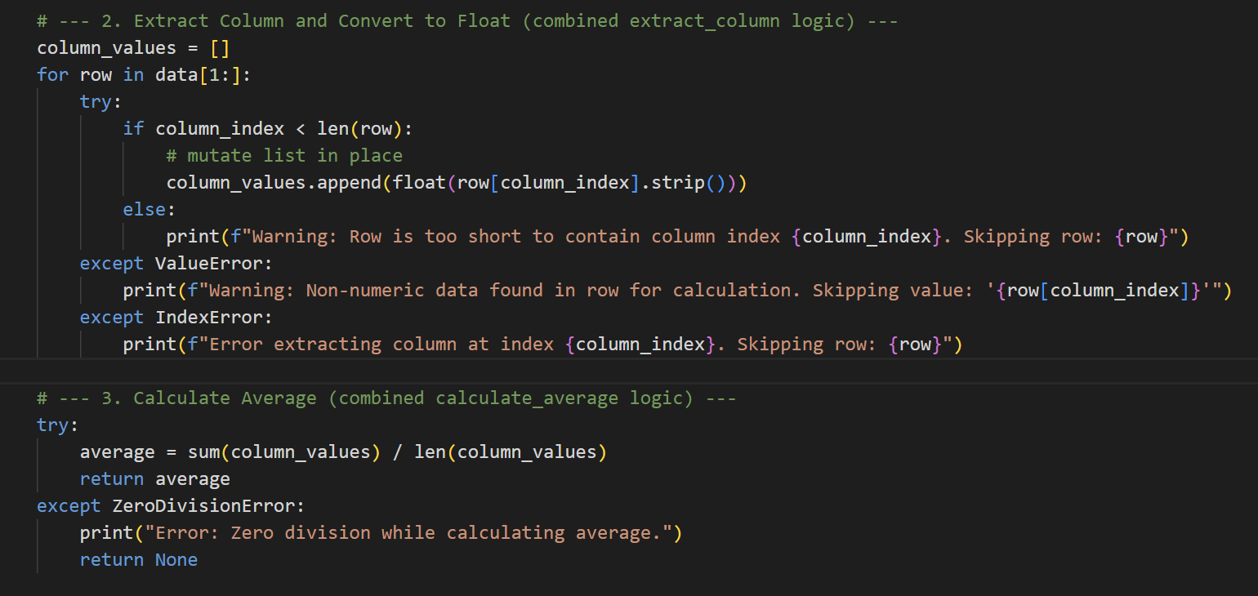
Mutate State: Take Care

Slide 17
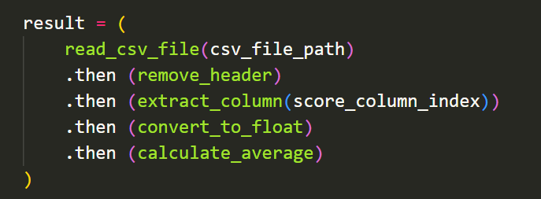
First step : focus on function composition
We need at least 3 concepts to achieve function composition in this style
Unary Function
Currying
Composition Technics

Slide 18
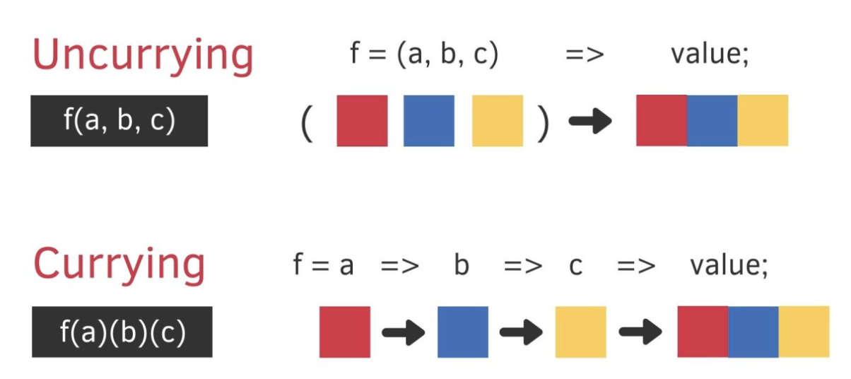
Currying and Higher Order Function
A higher-order function is a function that either takes one or more functions as arguments or returns a function as its result.
Currying is a technique where a function that takes multiple arguments is transformed into a sequence of functions, each taking a single argument.

Slide 19
Arity :> Unary : Why currying is so important
Unary Functions: Unary functions (functions that take a single argument) are often considered simpler to compose.
f(x)
g(x)
h(x)
compose(f, g, h)(x)

Slide 20
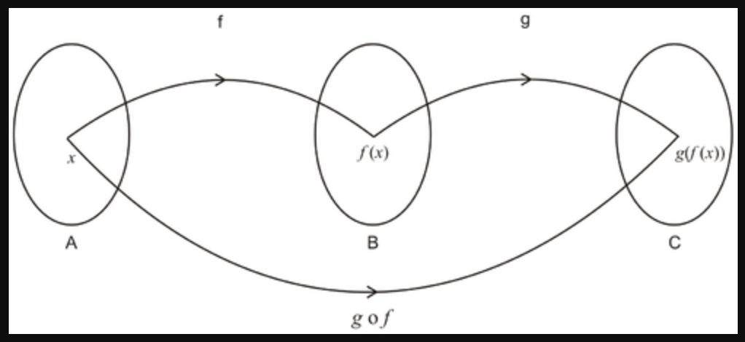
Function Composition
g.f(x) = g(f(x))
Example:
basic_call = subtract_five(multiply_by_three(add_two(2)))
chain_call = pipe(2, add_two, multiply_by_three, subtract_five)

Slide 21
Purity
In functional programming, purity means that a function:
Always produces the same output for the same input
Has no observable side effects
If a function is pure, then calling it with the same inputs will always give the same output. That makes it referentially transparent — you can substitute the function call with its result anywhere in your code

Slide 22
Purity
the function return values are identical for identical arguments (no variation with local static variables, non-local variables, mutable reference arguments or input streams, i.e., referential transparency) aka Referential Transparency
the function has no side effects (no mutation of non-local variables, mutable reference arguments or input/output streams) aka No Side Effects
If a function is pure, then calling it with the same inputs will always give the same output. That makes it referentially transparent — you can substitute the function call with its result anywhere in your code

Slide 23
Purity
Function | Pure? | Reason
read_csv_file | ❌ No | Performs I/O, depends on external state
extract_column | ✅ Yes | Deterministic, no side effects
remove_row | ✅ Yes | Deterministic, no side effects
convert_to | ✅ Yes | Pure if converter is pure
calculate_average | ✅ Yes | Deterministic, no side effects
🔴 read_csv_file(file_path)
❌ Not Pure
Violates referential transparency: Depends on external file system state. Same file_path may yield different results if the file changes.
Has side effects: Performs I/O (file reading), which is inherently impure

Slide 24
Purity
🔴 read_csv_file(file_path)
❌ Not Pure
Violates referential transparency: Depends on external file system state. Same file_path may yield different results if the file changes.
Has side effects: Performs I/O (file reading), which is inherently impure

Slide 25
Purity
✅ In extract_column(column_index, data):
It does not mutate anything.
It does not perform I/O.
It returns the same result for the same inputs — either a list of values or None if the index is invalid.
So even though it handles exceptions, it’s still referentially transparent and side-effect-free

Slide 26
Error Handling
In FP, we often model errors explicitly using:
Option / None
Either / Try
Result types
Your use of try/except is a Python-native way to express the same idea. If you wrapped it in a Try monad, it would be even more idiomatic in Scala or functional Ruby.

Slide 27
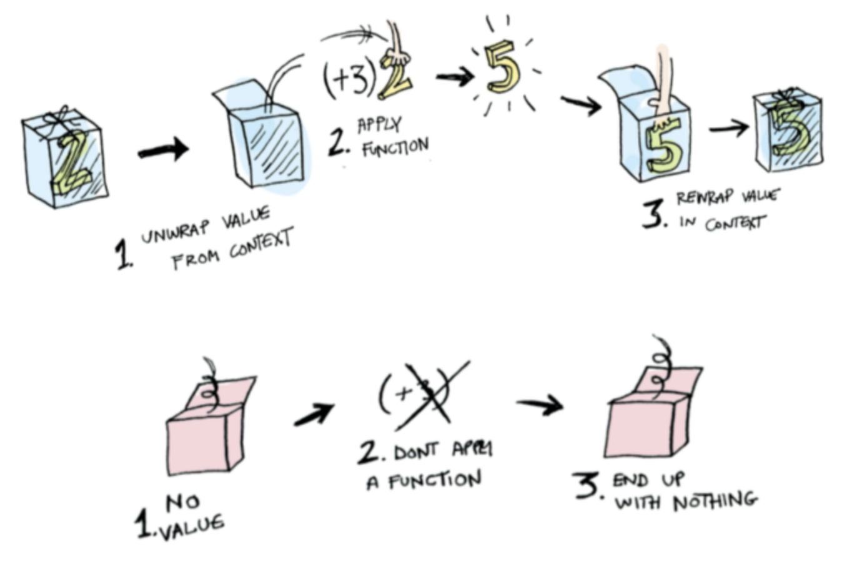
Monad
Monads apply a function that returns a wrapped value to a wrapped value.
Credit to https://www.adit.io/posts/2013-04-17-functors,_applicatives,_and_monads_in_pictures.html

Slide 28
Maybe
Some
Nothing
Maybe
Apply
Function
Maybe
Bind >>=
Maybe
Apply
Function
Maybe
Some
Some
Maybe
Maybe
Nothing
Nothing

Slide 29
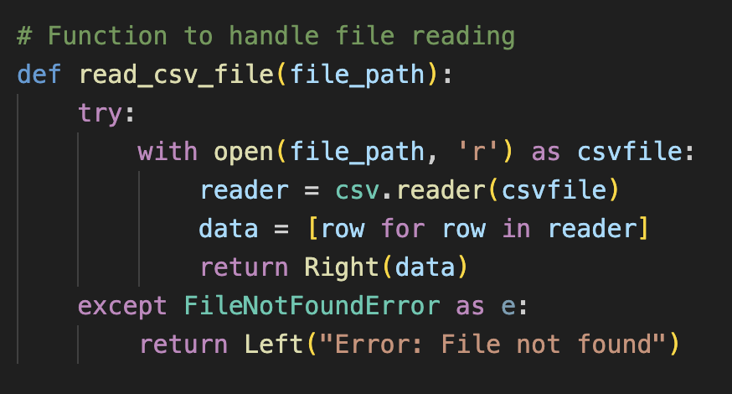
PyMonad: Monad (Either, Right or Left)
Apply function

Slide 30
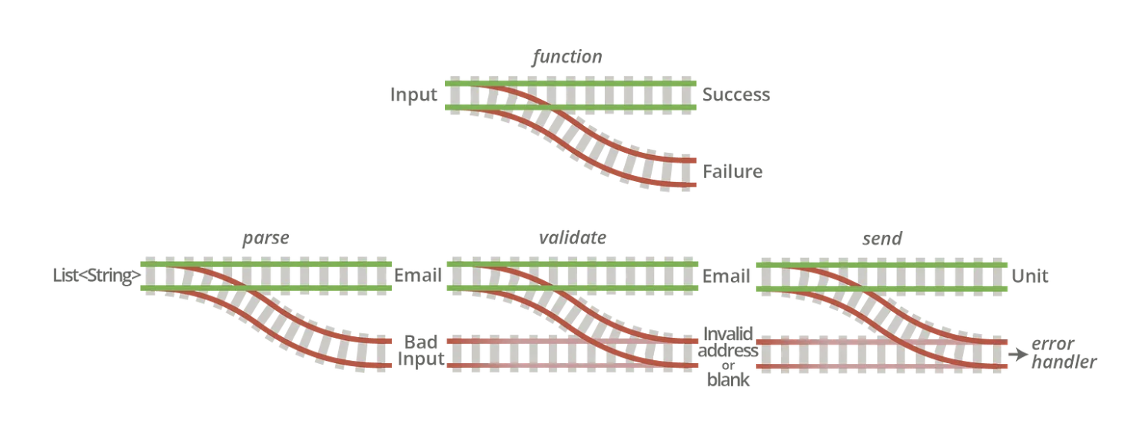
Monad and Railway Oriented Programming
ROP can be seen as an application of monadic principles to error handling, where the track represents the flow of computation, and the monad helps manage the context of success or failure.

Slide 31
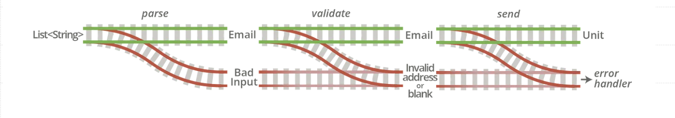
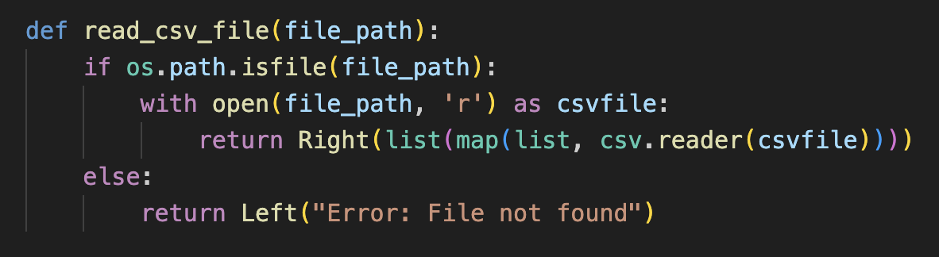
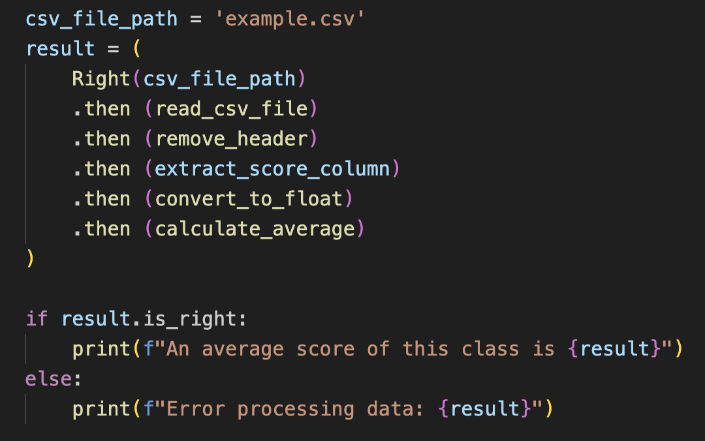
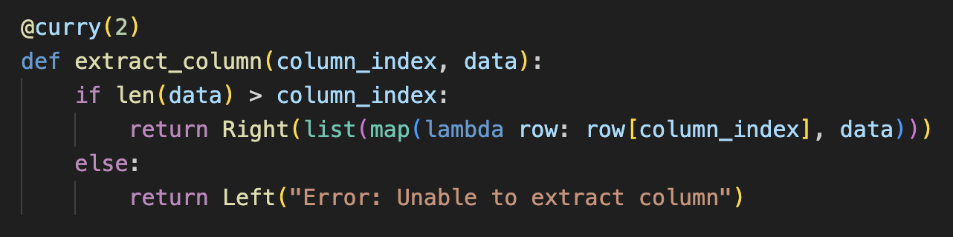

Slide 33
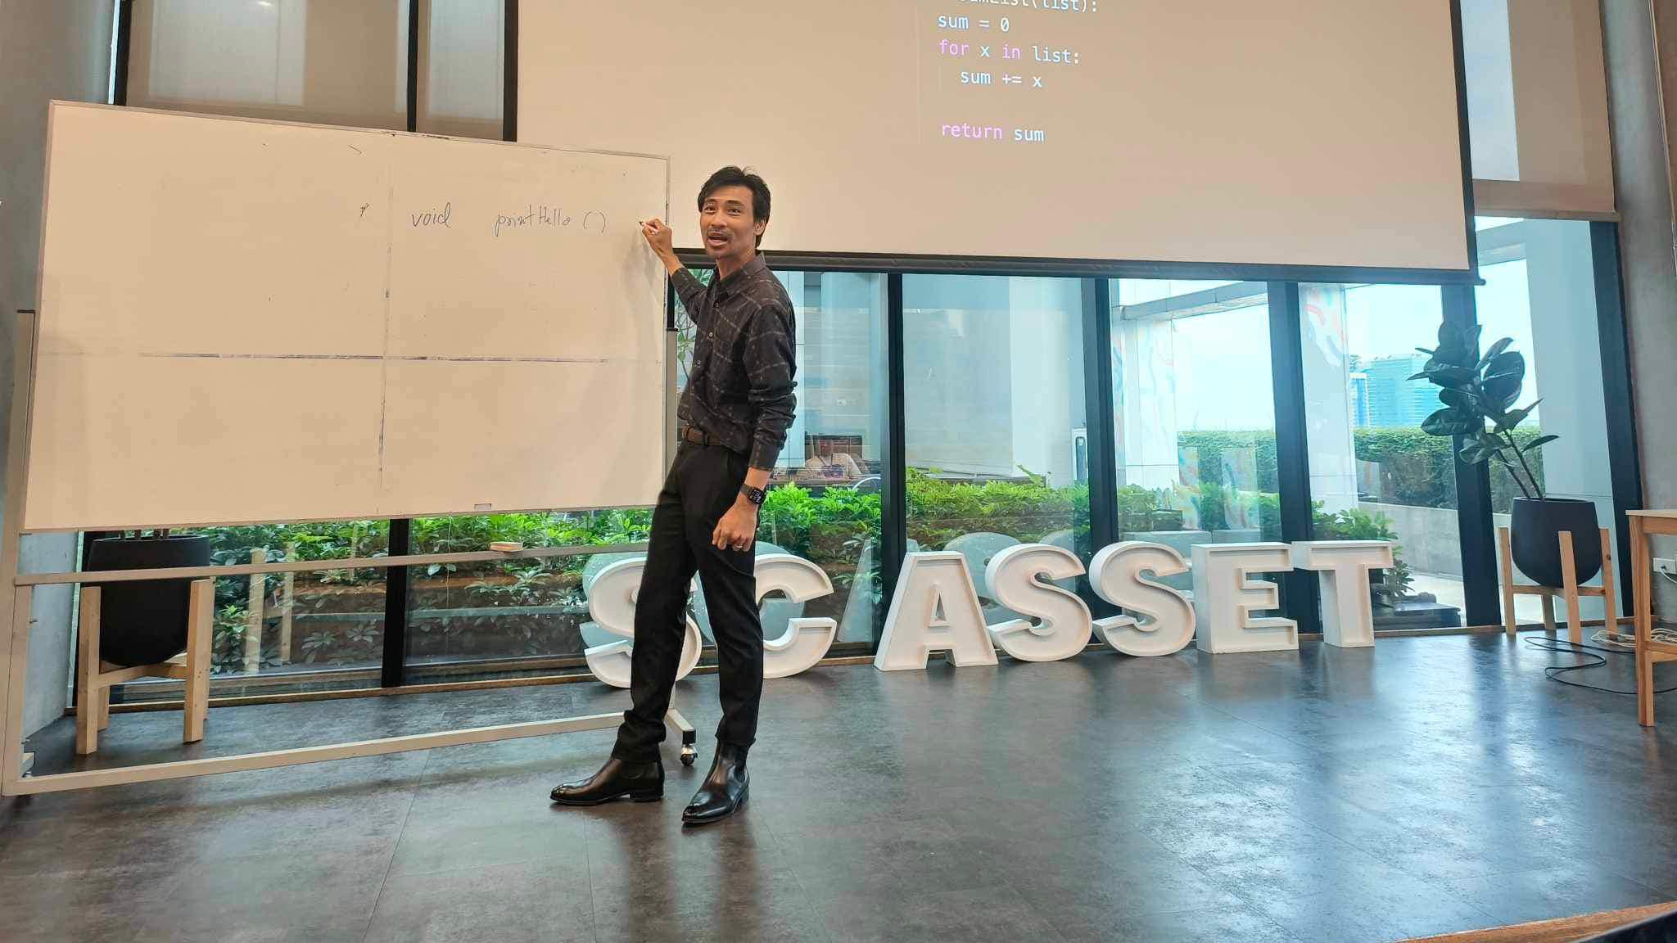
Credit
"Mathematics for working programmers" by Rawitat Pulam

